Slide 1
Component, deployment, package diagrams
OBJECT - ORIENTED ANALYSIS AND DESIGN
P PAVEENA – 2022503540

Slide 2
COMPONENT DIAGRAM
WHAT ARE COMPONENT DIAGRAMS?
Component diagrams are a type of structural diagram that illustrate the organization and relationships among components in a system.
They are particularly useful in visualizing the high-level architecture of a software system, highlighting how components interact and depend on one another.
It visualizes the relationships as well as the organization between the components present in the system.
WHAT IS A COMPONENT?
A component is a single unit of the system, which is replaceable and executable.
The implementation details of a component are hidden, and it necessitates an interface to execute a function.
It is like a black box whose behavior is explained by the provided and required interfaces

Slide 3

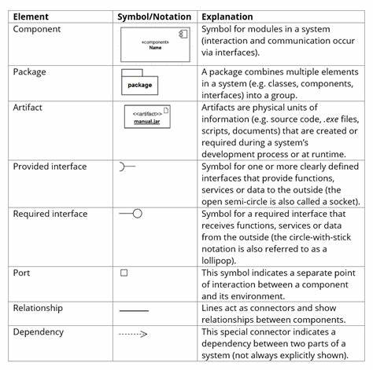

NOTATIONS IN COMPONENT DIAGRAM
COMPONENT
A rectangle with the component's name
A rectangle with the component icon
A rectangle with the stereotype text and/or icon
INTERFACE
Shown as circles or lollipops, interfaces define the points of interaction between components.
Provided Interface
Required Interface
PORT
A port is often used to help expose required and provided interfaces of a component.

Slide 4

NOTATIONS IN COMPONENT DIAGRAM
RELATIONSHIP
Association: specifies a semantic relationship that can occur between typed instances.
Composition: aggregation that requires a part instance be included in at most one composite at a time.
Aggregration: A kind of association that has one of its end marked shared as kind of aggregation, meaning that it has a shared aggregation.
Constraint: A condition or restriction expressed in natural language text or in a machine readable language for the purpose of declaring some of the semantics of an element.
Dependency: A dependency is a relationship that signifies that a single or a set of model elements requires other model elements for their specification or implementation.
PACKAGES
Components can be grouped into packages to organize related components.

Slide 5
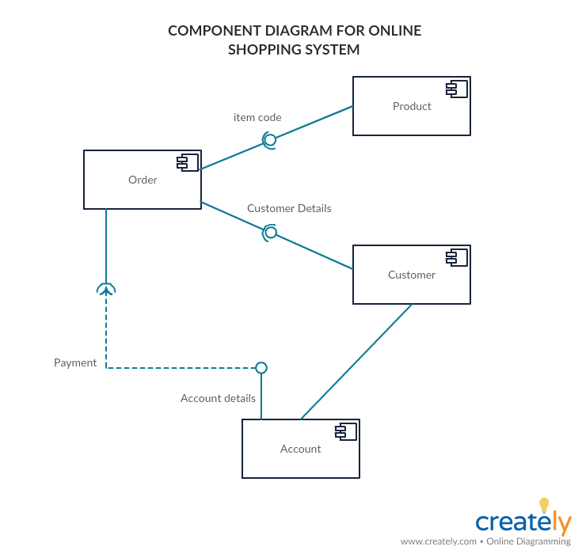
COMPONENT DIAGRAM EXAMPLE

Slide 6
DEPLOYMENT DIAGRAM
WHAT ARE DEPLOYMENT DIAGRAMS?
A deployment diagram is a diagram that shows the configuration of run andtime processing nodes the components that live on them.
Deployment diagrams is a kind of structure diagram used in modeling the physical aspects of an object-oriented system.
They are often be used to model the static deployment view of a system (topology of the hardware).
WHY USE DEPLOYMENT DIAGRAMS?
They show the structure of the run-time system
They capture the hardware that will be used to implement the system and the links between different items of hardware.
They model physical hardware elements and the communication paths between them
They can be used to plan the architecture of a system.
They are also useful for Document the deployment of software components or nodes

Slide 7
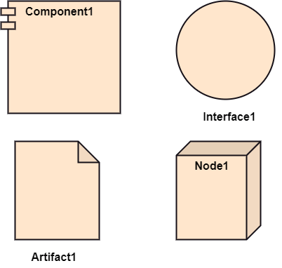
NOTATIONS IN DEPLOYMENT DIAGRAM
COMPONENT
Represented as rectangles with a smaller rectangle in the corner, components can be deployed on nodes to show how software is organized and deployed.
NODES
Physical Nodes: Represented as three-dimensional boxes, they depict physical hardware such as servers, devices, or any computing resources.
Execution Environments: Can also be represented as nodes, indicating where components run (e.g., a JVM for Java applications).
ARTIFACTS
Represented as rectangles, artifacts are the physical pieces of information (like executable files, libraries, or databases) that are deployed on nodes.
INTERFACES
Interfaces define the communication protocols or methods that allow different components or nodes to interact.

Slide 8
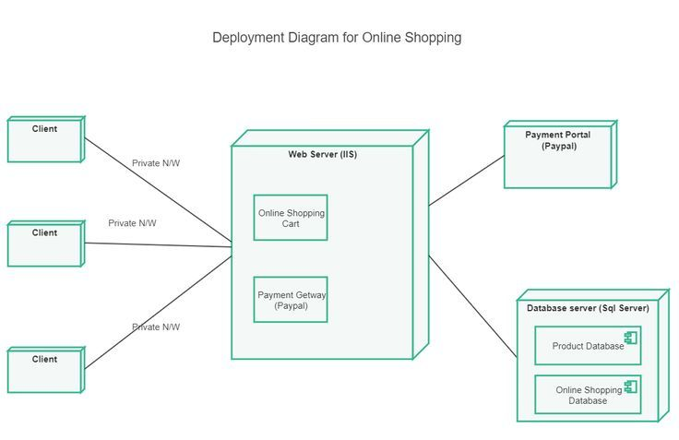
DEPLOYMENT DIAGRAM EXAMPLE

Slide 9
PACKAGE DIAGRAM
WHAT ARE PACKAGE DIAGRAMS?
A package diagram is a type of Unified Modeling Language (UML) diagram mainly used to represent the organization and the structure of a system in the form of packages.
WHY USE PACKAGE DIAGRAMS?
Organizing Complexity: By grouping related elements, package diagrams help manage complex systems, making them easier to understand and maintain.
Dependency Management: They provide a clear view of how different parts of the system depend on one another, which is useful for impact analysis.
Documentation: Package diagrams serve as documentation for the system architecture, making it easier for developers and stakeholders to understand the structure.

Slide 10
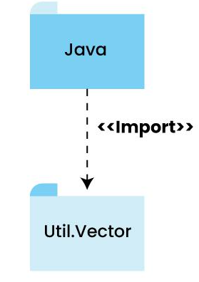
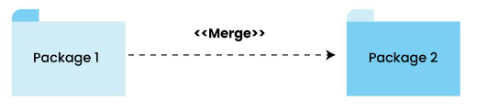
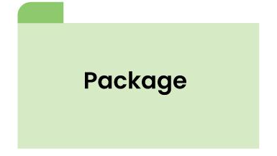
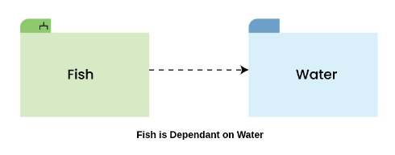
NOTATIONS IN PACKAGE DIAGRAM
PACKAGE
It is a container for organizing different diagram elements such as classes, interfaces, etc. It is represented in the Diagram in a folder-like icon with its name.
DEPENDENCY
Dashed arrows between packages indicate dependencies. A package A that depends on package B suggests that changes in B might affect A.
PACKAGE MERGE
It is a relationship that signifies how a package can be merged or combined.
PACKAGE IMPORT
It is another relationship that shows one package’s access to the contents of a different package.

Slide 11
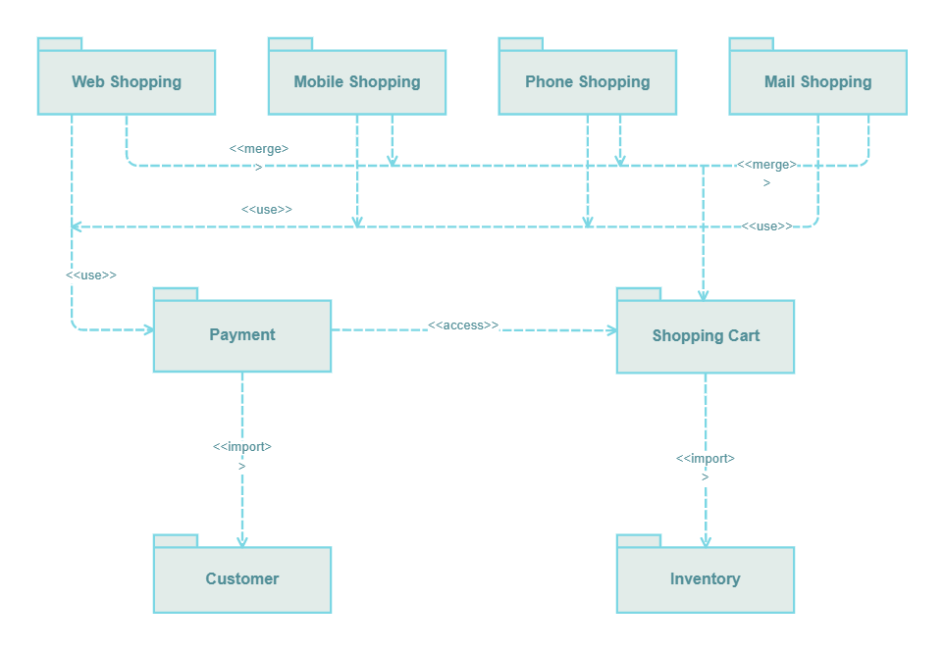
PACKAGE DIAGRAM EXAMPLE (ONLINE SHOPPING)

